Slide 1
College Course Registration System Madjany Lamour

Slide 2
Agenda
SRS Document: Key Aspects
UML Design Model
landing, Login & Registration Pages
MySQL Database & Class Registration
PHP Code Highlights

Slide 3
Madjany Lamour University of Arizona Global Campus CST 499: Capstone for Computer Software Technology Professor Joseph Rangitsch June 15, 2025

Slide 4
SRS Document: Key Aspects
Purpose: Enable students to register for courses online
Scope: Landing page, user registration, login, enrollment modules
Functional Requirements: User CRUD, authentication, data validation
Non-Functional: Security via password hashing, responsive design
UML and ER diagrams define system structure and data relationships

Slide 5
UML Design Models USECASE CLASS SEQUENCE ACTIVITY STATE

Slide 6
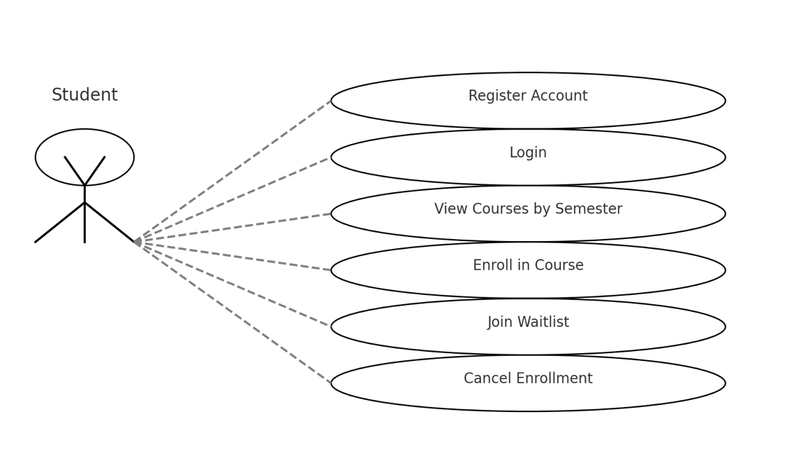

Use Case Diagram

Slide 7
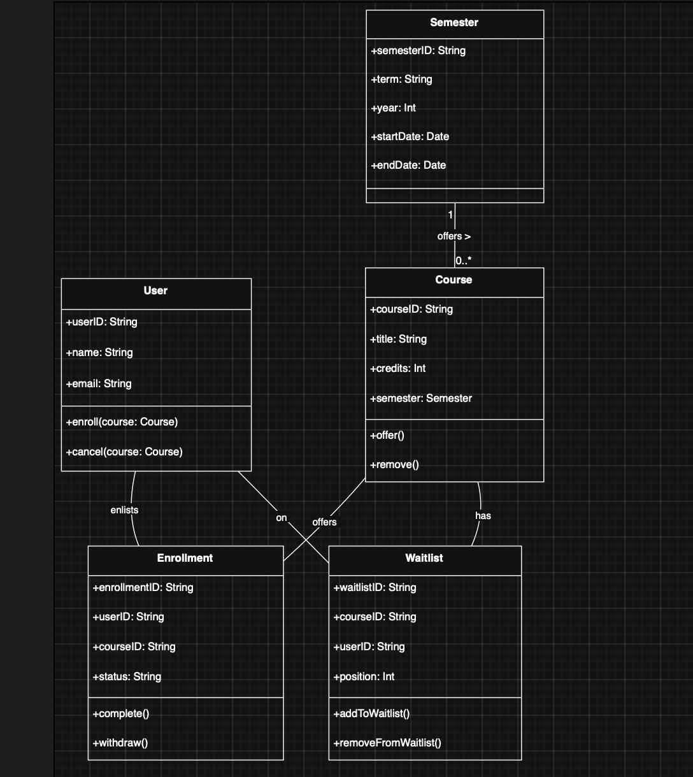
Class Diagram

Slide 8
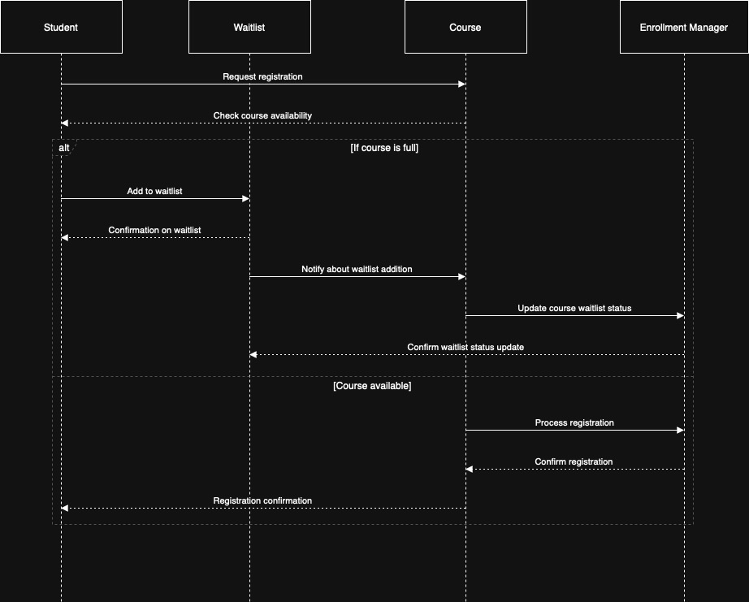
Sequence Diagram

Slide 9
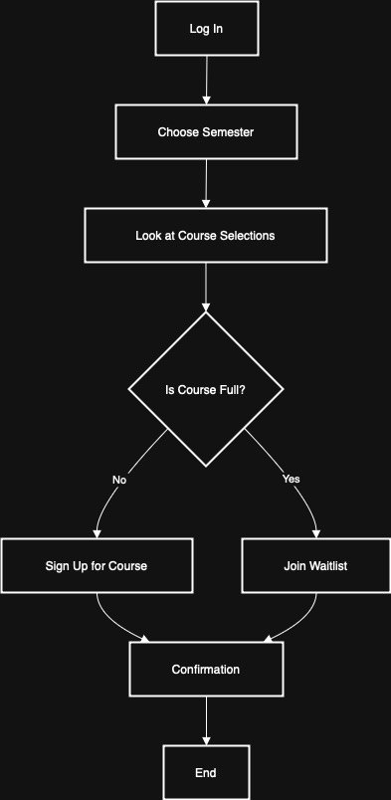
Activity Diagram

Slide 10
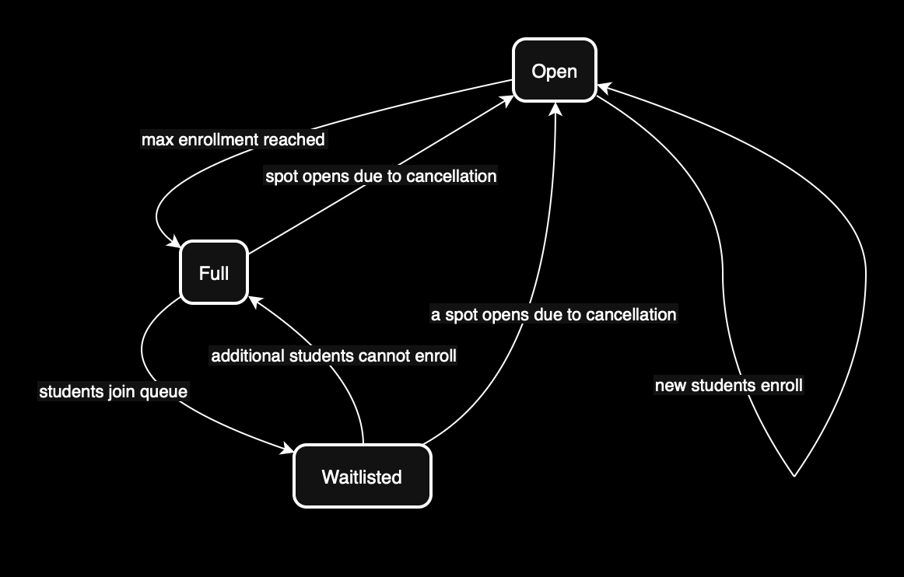
State diagram

Slide 11
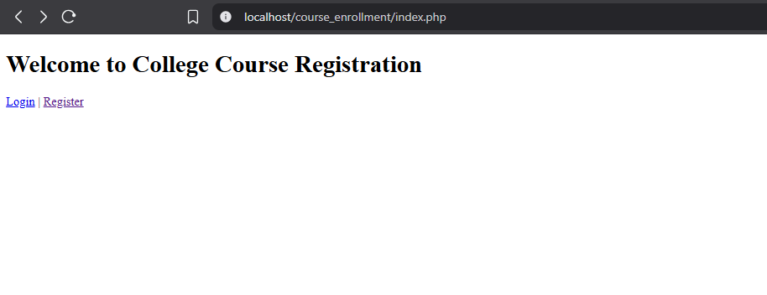
Landing, Login & Registration Pages
Landing Page: Navigation links to Login & Register

Slide 12
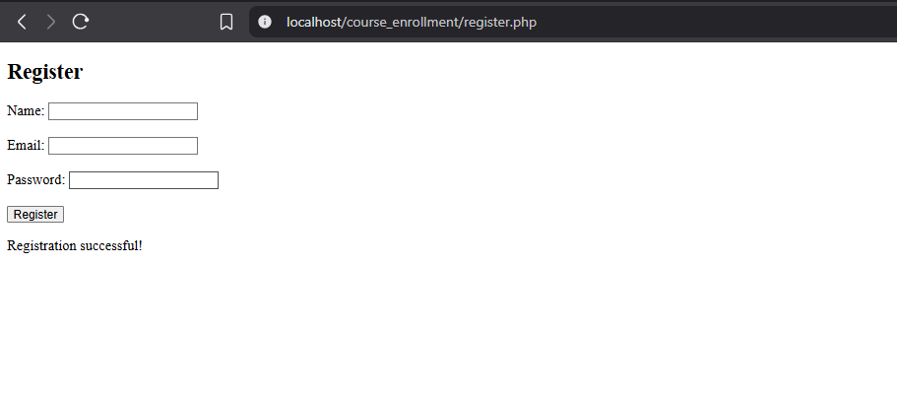
Landing, Login & Registration Pages
Registration Page: Form for Name, Email, Password

Slide 13
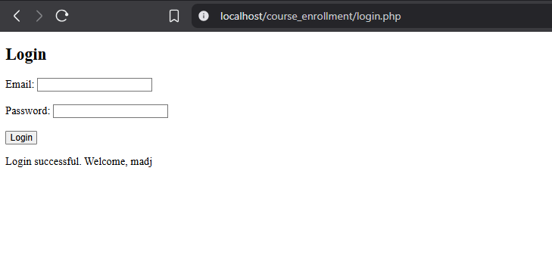
Landing, Login & Registration Pages
Login Page: Form for Email & Password with verification

Slide 14
MySQL Database & Class Registration
Database: college_portal with table users
Columns: id, full_name, email, password, created_at
Primary Key on id, Unique constraint on email
Timestamp for record creation
Use of PDO for secure connections and queries

Slide 15

PHP Code Highlights
db.php: Database connection class using PDO
register.php: User input handling, password hashing, prepared statements
login.php: Credential verification with password_verify()
Error handling and user feedback messages
Scalable structure for future feature additions

Slide 16
THANK YOU

Slide 17
References
Chacon, S., & Straub, B. (2014). Pro Git (2nd ed.). Apress. https://git-scm.com/book/en/v2
Spinellis, D. (2005). Version control systems. IEEE Software, 22(5), 108–109. https://doi.org/10.1109/MS.2005.151
Tsui, F., Karam, O., & Bernal, B. (2018). Essentials of software engineering (4th ed.). Jones & Bartlett Learning.
Connolly, R., & Hoar, R. (2022). Fundamentals of web development (3rd ed.). Pearson.
Mikoluk, K. (2013, September 18). XAMPP tutorial: How to use XAMPP to run your own web serverLinks to an external site.. Udemy. https://blog.udemy.com/xampp-tutorial
Oh, S. (n.d.). Bootstrap: Tutorial 7Links to an external site.. University of Toronto. https://www.cs.toronto.edu/~mashiyat/csc309/Tutorial/6/Bootstrap.pdf
Nzube, O. E. (2024, October 8). PHP tutorial – How to setup PHP and XAMPP for your project. freeCodeCamp.org. https://www.freecodecamp.org/news/how-to-get-started-with-php/

